Slide 1

Public Health
Certificate Program
(PHCP)
Co-Directors:
Hillary CM Nelson, PhD MPH
Ricardo Castillo Neyra, PhD DVM MSPH
Student Representative:
Nina Montoya (MVP)
Biomedical Graduate Studies

Slide 2






Public Health on Penn’s Campus

Slide 3




What are the requirements?
Formal coursework in public health
Public health project
Bi-weekly seminars

Slide 4



PHCP Seminar Series
ALL WELCOME!!!!
Breakfast seminars @ 8:30 am
- Tuesdays (biweekly) in fall
- Wednesdays (biweekly) in spring

Slide 5


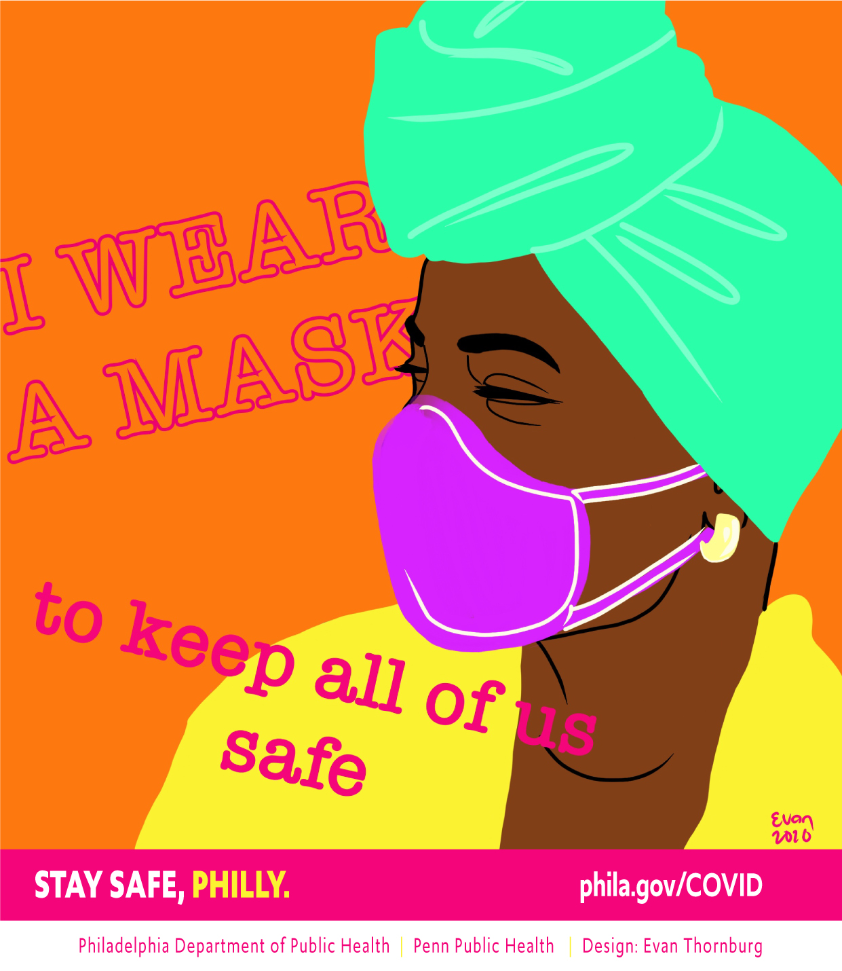
Nina’s PHCP Project
PHCP coursework:
Foundations in Public Health
Intro to Epidemiology
Mathematical Models of Infectious Disease
Health Communication in the Digital Age
COVID-19 Comms Team

Slide 6
PHCP Alumni
Faculty and postdoctoral fellow positions (various)
Industry positions (various)
Research Scientist, Newborn Screening Program at the New Jersey Department of Health (this followed an ASPL/CDC Emerging Infectious Disease fellowship)
Project Director, Biomedical Programs at The Pew Charitable Trusts
NIH CPEP Accredited Microbiology Fellow, now running clinical microbiology lab in NYC
California Epidemiology Investigation Service Fellow

Slide 7
Contact Info
Hillary Nelson, PhD MPH
hnelson@pennmedicine.upenn.edu
Ricardo Castillo-Neyra, PhD, DVM, MSPH
cricardo@pennmedicine.upenn.edu
Anne-Cara Apple (PHCP Coordinator)
annecara@pennmedicine.upenn.edu
Current PHCP Students:
CAMB/MVP: Elisha Segrist, Prioty Sarwar, Emily Cribas, Kevin Hernandez, Brianne Roper, Jorge Acuna, Daniel Kim, Jaydeen Sewell
CAMB/GGR: Dan Ju, Danielle Brokaw
CAMB/CB: Michael Noji
IMMUN: Sarah Sneed, Andrew Hart, Seble Negatu
PHRM: Kyla Mace, Eliana von Krusenstiem, Samuelle Delcy
NGG: Jaffna Mathiaparanam
BMB: Matthew Martinez

